Slide 1
Inter-thread Communication in Java

Slide 2
Inter-thread Communication in Java
Inter-thread communication or Co-operation is all about allowing synchronized threads to communicate with each other.
Cooperation (Inter-thread communication) is a mechanism in which a thread is paused running in its critical section and another thread is allowed to enter (or lock) in the same critical section to be executed.It is implemented by following methods of Object class:
wait()
notify()
notifyAll()
They must be used within a synchronized block only.

Slide 3
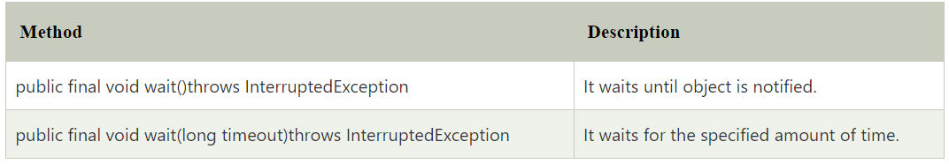
wait() method
The wait() method causes current thread to release the lock and wait until either another thread invokes the notify() method or the notifyAll() method for this object, or a specified amount of time has elapsed.
The current thread must own this object's monitor, so it must be called from the synchronized method only otherwise it will throw exception

Slide 4
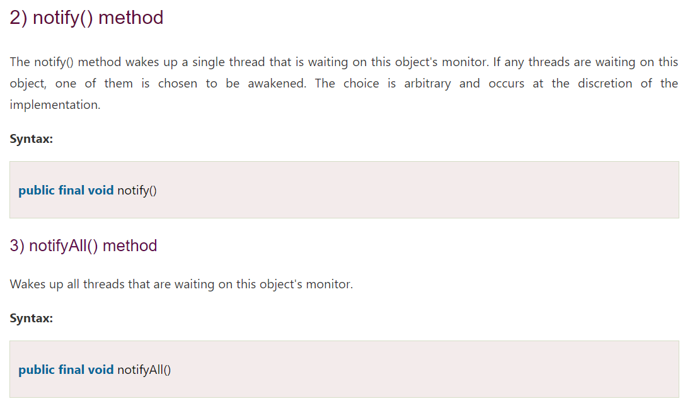

Slide 5
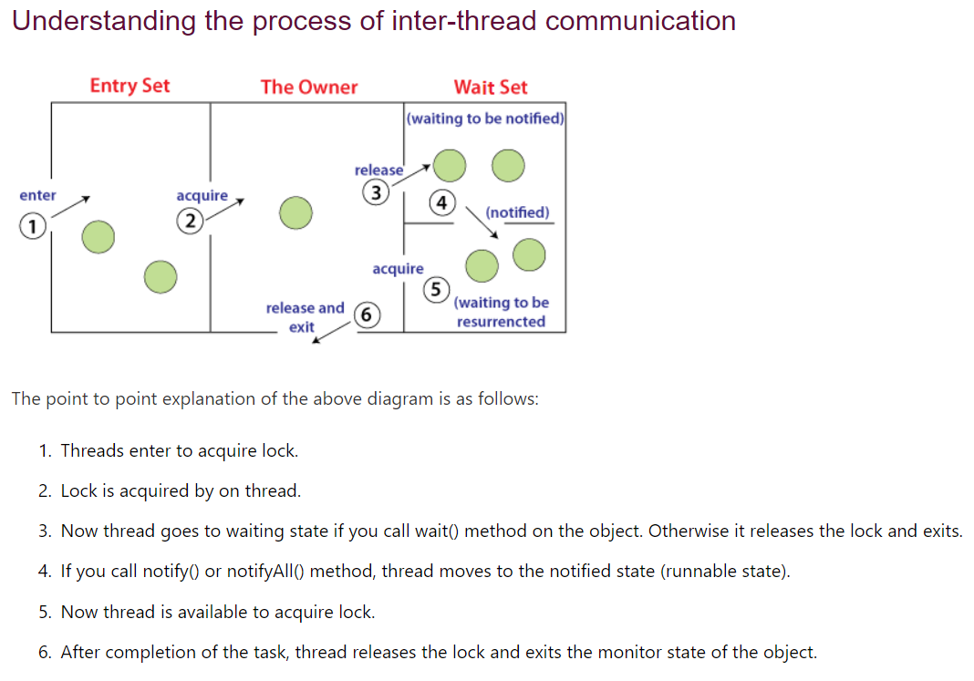

Slide 6
Acquiring Lock:
Threads enter synchronized blocks to acquire locks.
If a lock is available, the thread acquires it and proceeds with execution.
Waiting State:
Calling wait() on an object releases the lock and puts the thread into a waiting state.
Threads remain in this state until notified by another thread via notify() or notifyAll().
Notified State (Runnable State):
Upon notification, threads move to a notified or runnable state.
They compete to reacquire the lock once it's available.
Reacquiring Lock:
Notified threads regain the lock and resume execution.
Order of lock acquisition may depend on thread scheduling and fairness settings.
Releasing Lock and Exiting:
Upon completing synchronized tasks, threads release the lock.
Exiting synchronized blocks/methods transitions threads out of the monitor state.

Slide 7
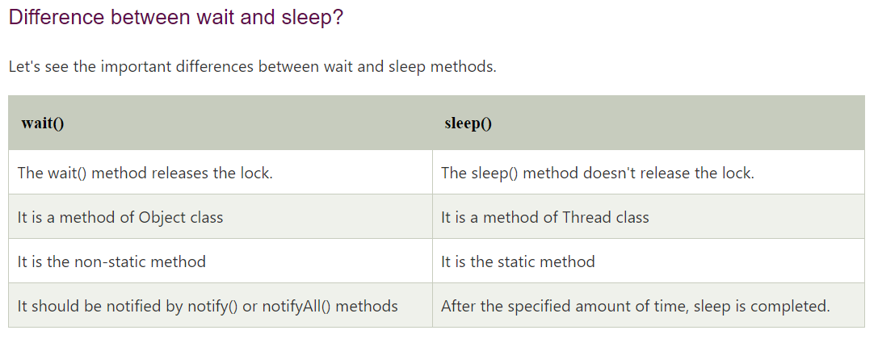

Slide 8
Example of Inter Thread Communication in Java
Let's see the simple example of inter thread communication.
Test.java

Slide 9
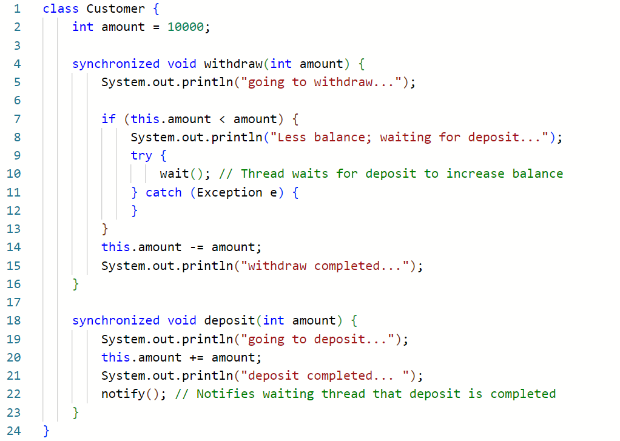

Slide 10
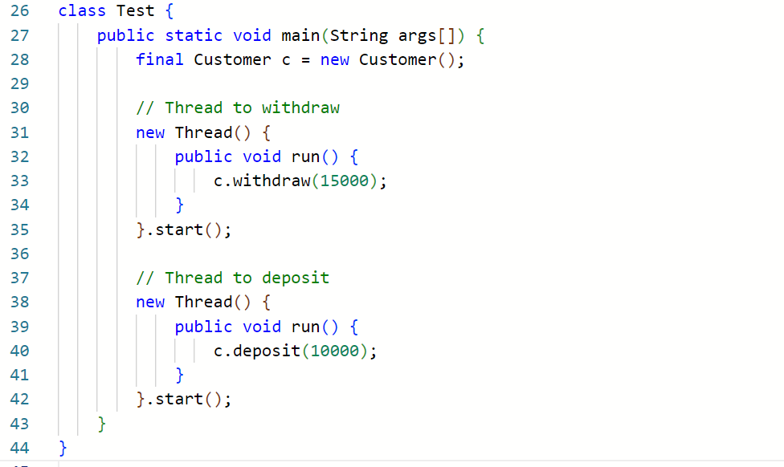
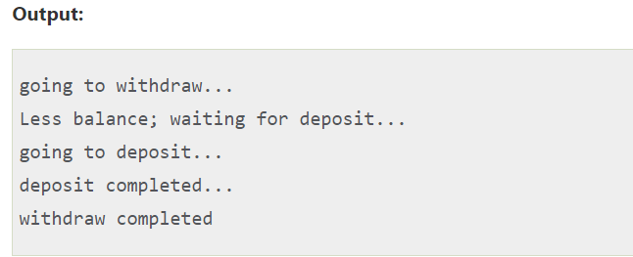

Slide 11
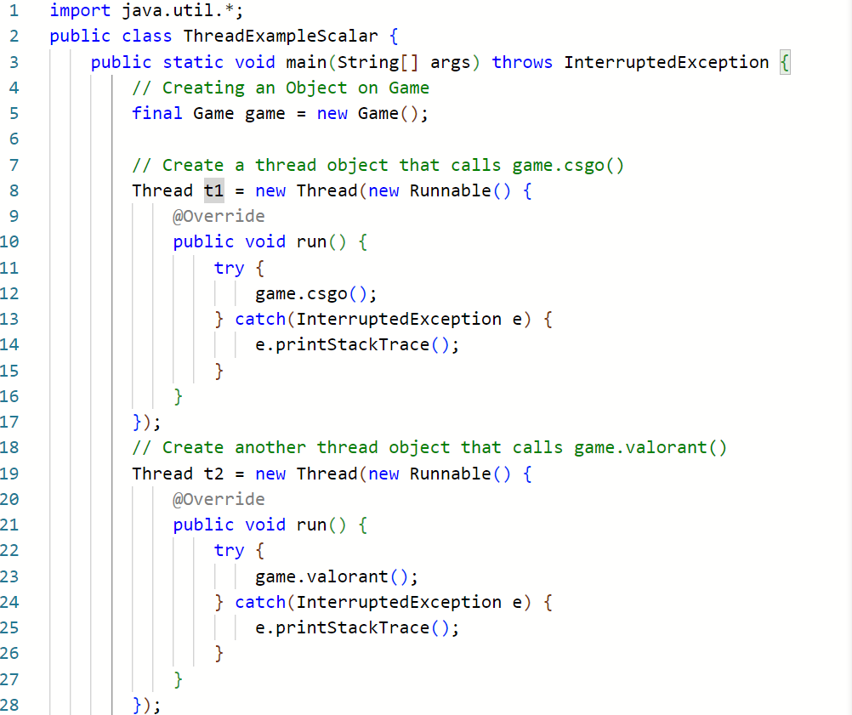

Slide 12
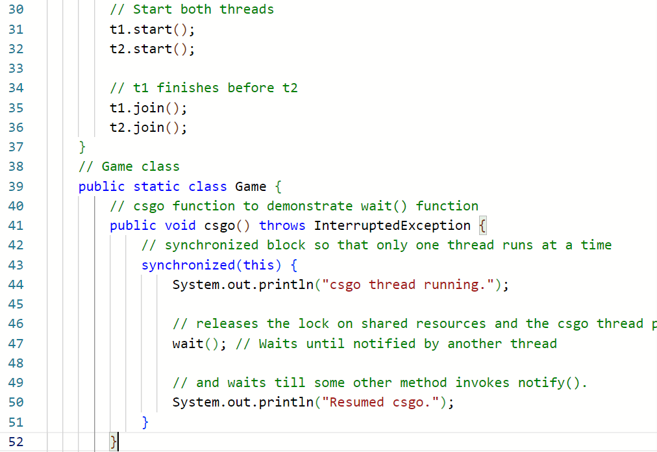

Slide 13
